Slide 1


TRiCAM QRI Project Presentation
MICHELLE YANG, AKASH LEVY, ALBERT TUNG, JANETTE GARCIA

Slide 2
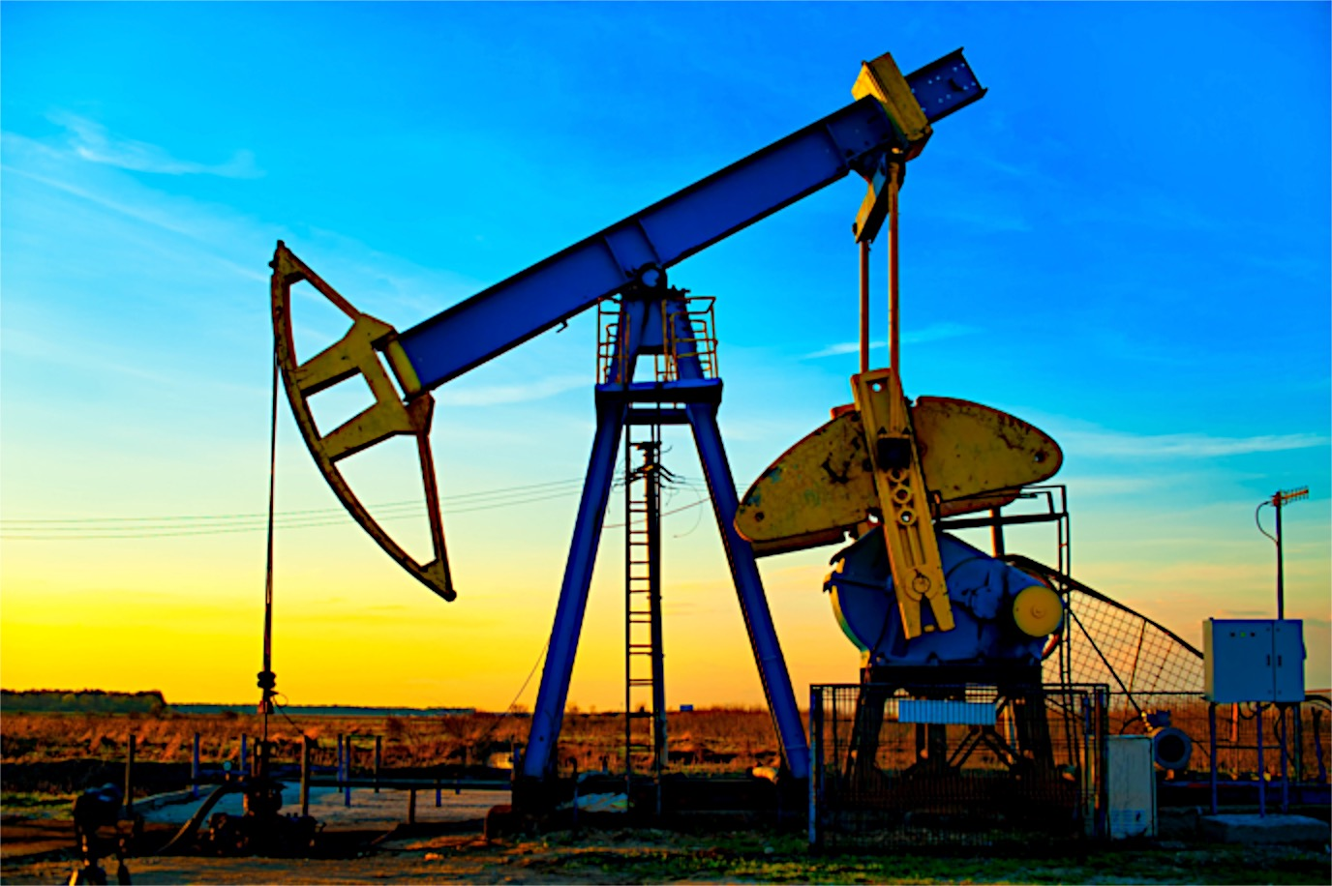
QRI Problem Summary
Goal: predict oil production rate in petroleum wells
Strategy: deep learning
Models:
Convolutional Neural Network (CNN)
Multilayer Perceptron (MLP)
Recurrent Neural Network (RNN)
Restricted Boltzmann Machine (RBM)

Slide 3
QRI Data – Current Preprocessing
Remove zeros
Split data into chunks of 36 months
Normalize data within each chunk
Step size of 1 month
Assign data to training, validation, and test sets
Based on different wells

Slide 4
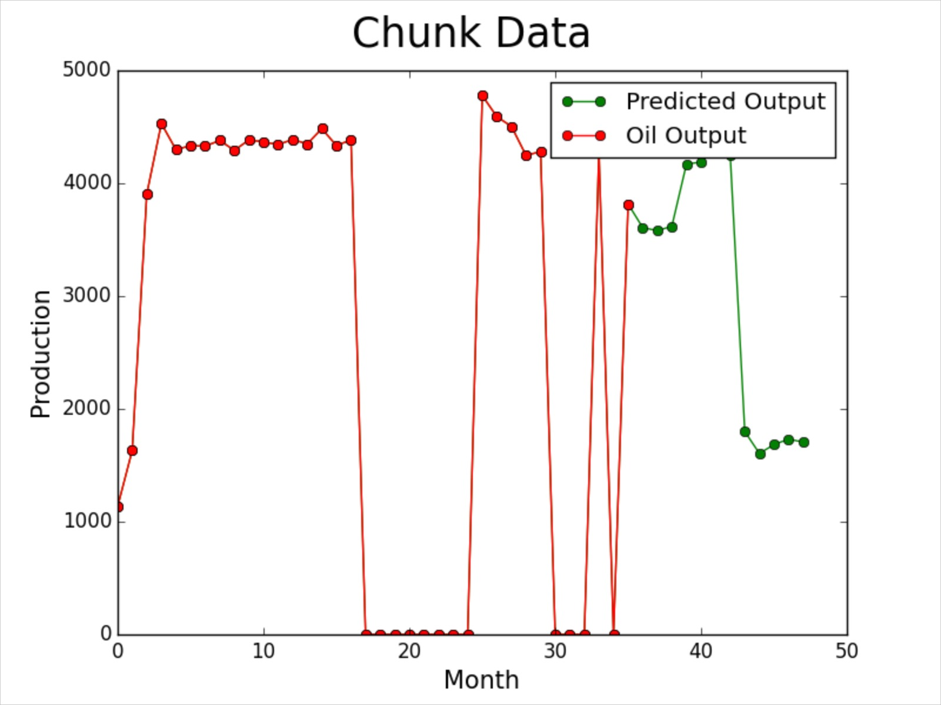
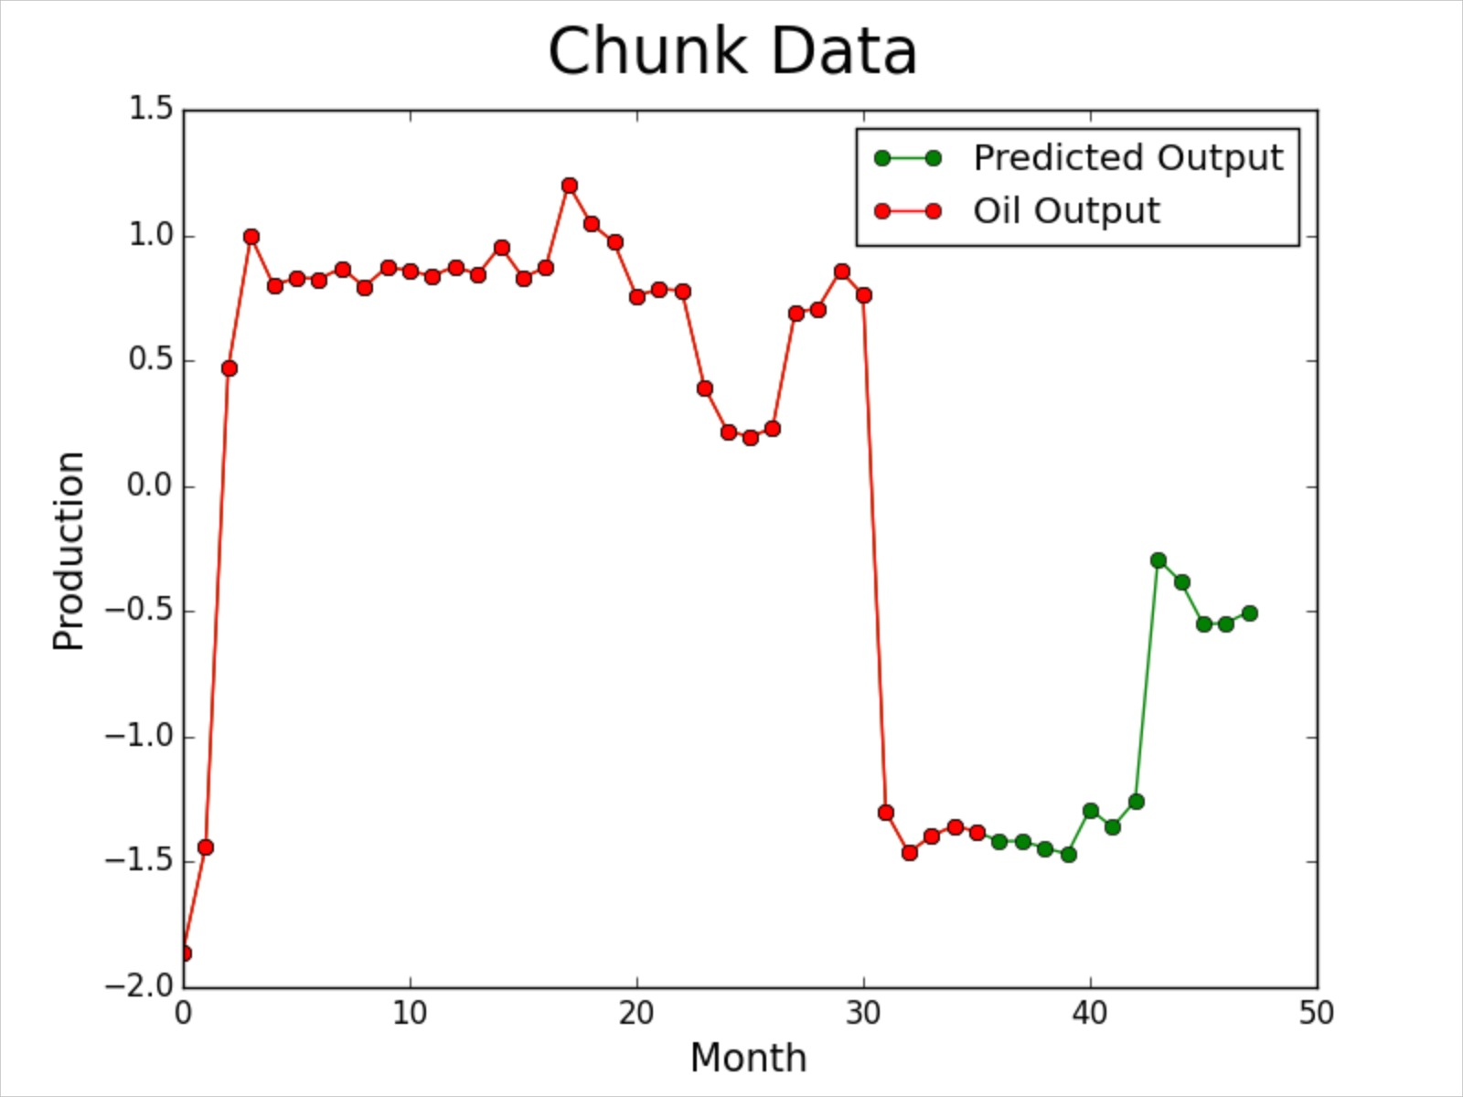
Sample Preprocessed Data
Original
After Preprocessing

Slide 5
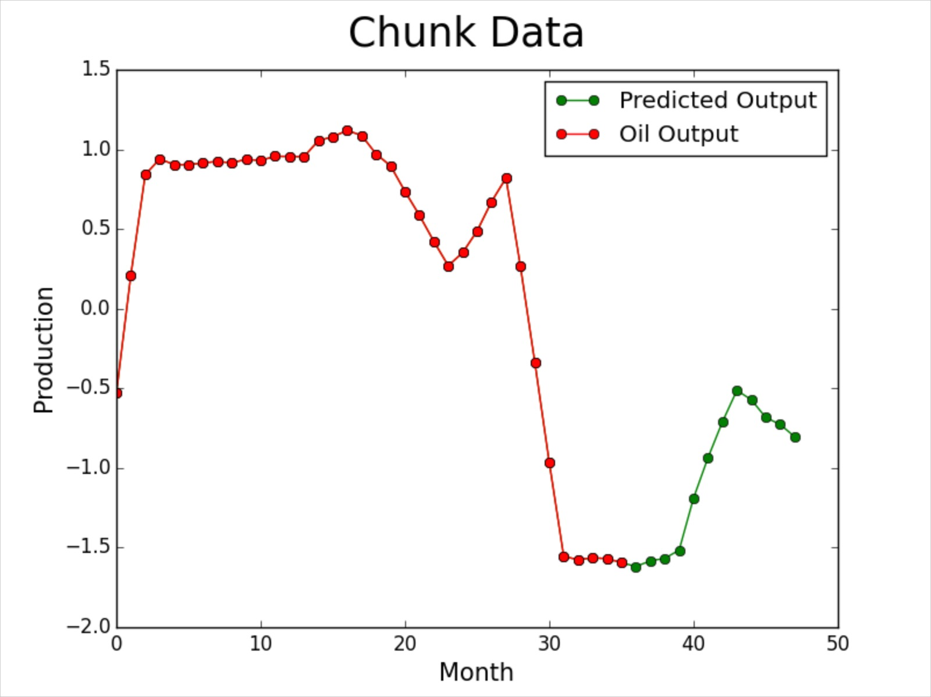
Additional Preprocessing Options
Smoothing data
Assign data to different sets based on site name

Slide 6
Odyssey Clusters
Successfully set up
Ran on CPU
Next Step: running on GPU

Slide 7
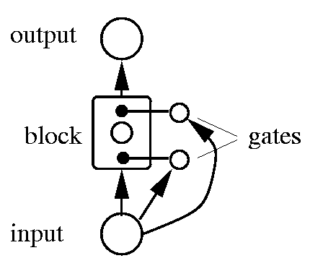
Recurrent Neural Networks (RNN)
Ran on character-level language models:
Predicted lowest-level term
Developing Long Short Term Memory Model (LSTM)

Slide 8
Restricted Boltzmann Machines (RBM)
Ran MNIST data
Developing for use on QRI data:
Modifying shape of input data

Slide 9
Convolutional Neural Network (CNN)
Working model on QRI data
Hidden layers: 2
Fully-connected layer: 1
Filter per layer: 12
Activation Function: tanh
Batch size: 200
Learning rate: 0.01
Momentum: 0

Slide 10
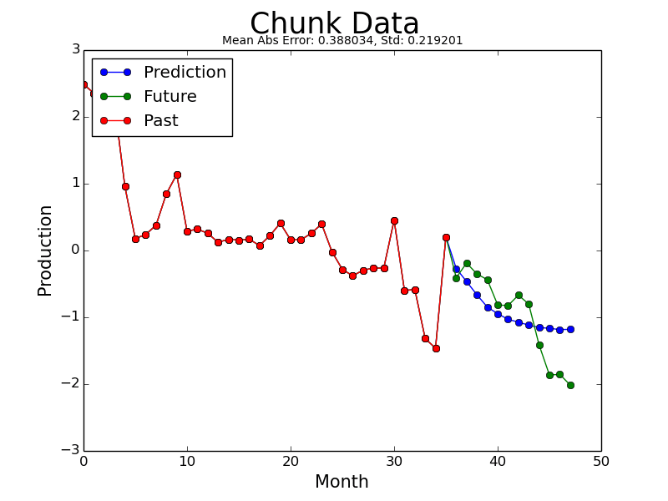
CNN on QRI Data
Animated prediction

Slide 11
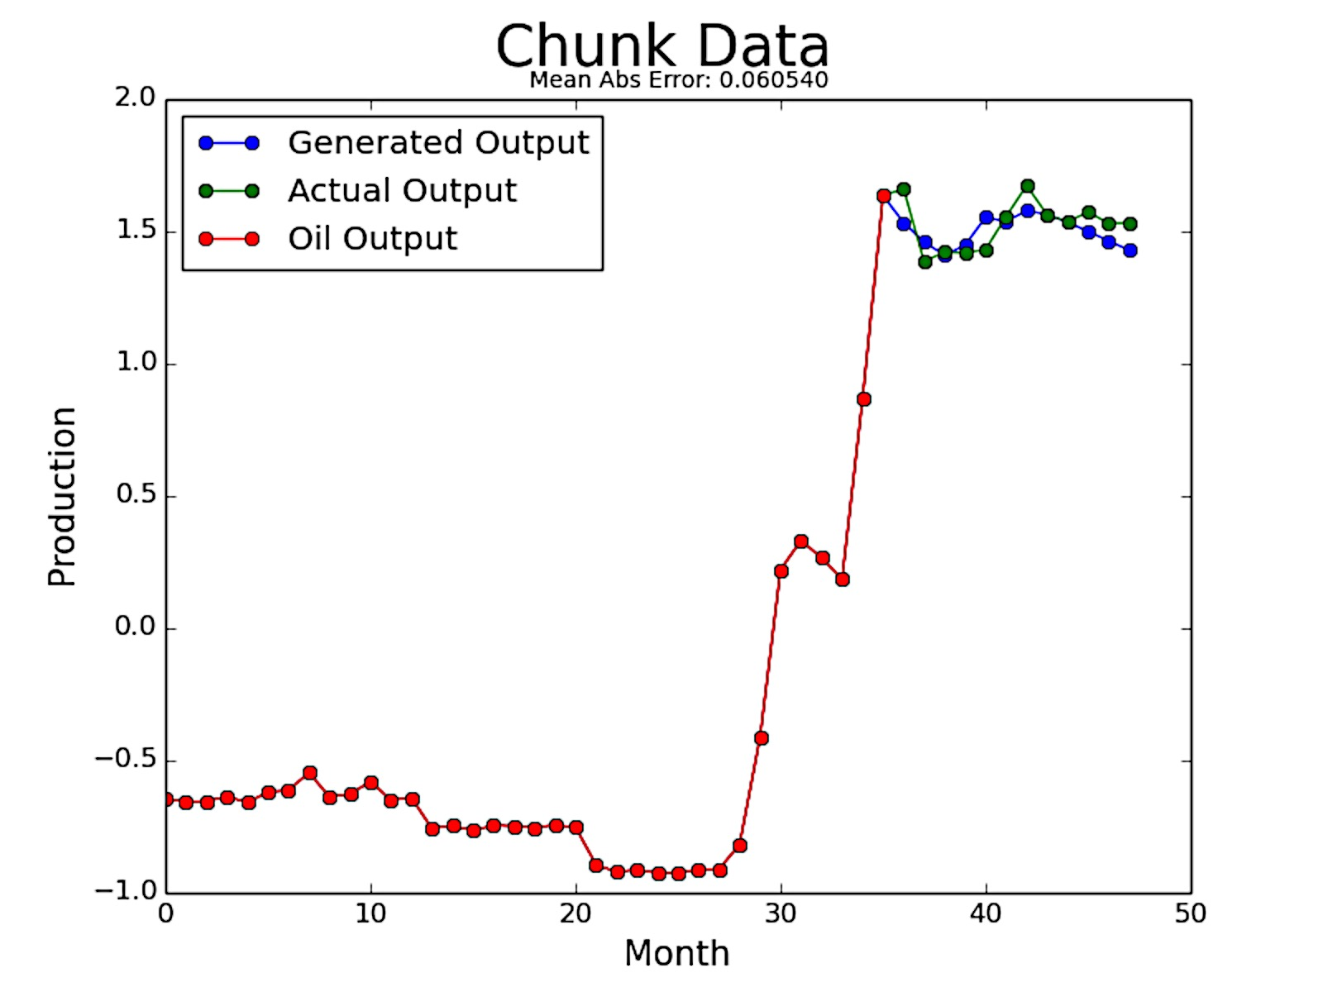
Multilayer Perceptron (MLP)
Changed from autoencoders
Currently produces best results on QRI data
Hidden layers: 4
Neurons: 300
Activation Function: tanh
Batch size: 273
Learning rate: 0.01
Momentum: 0.5

Slide 12
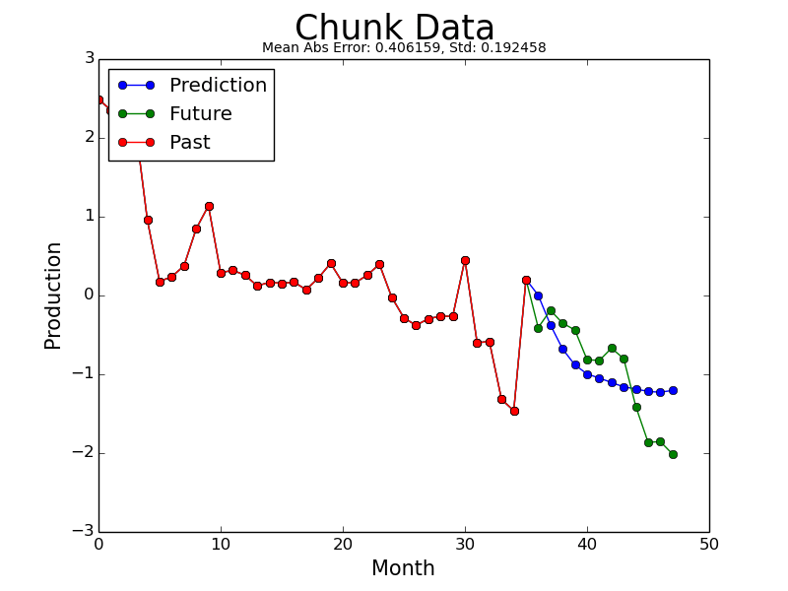
MLP on QRI Data
Animated prediction

Slide 13
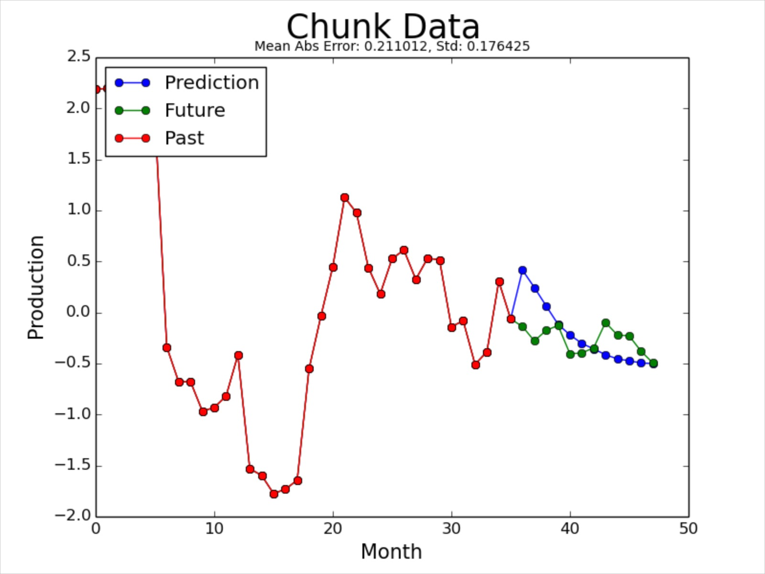
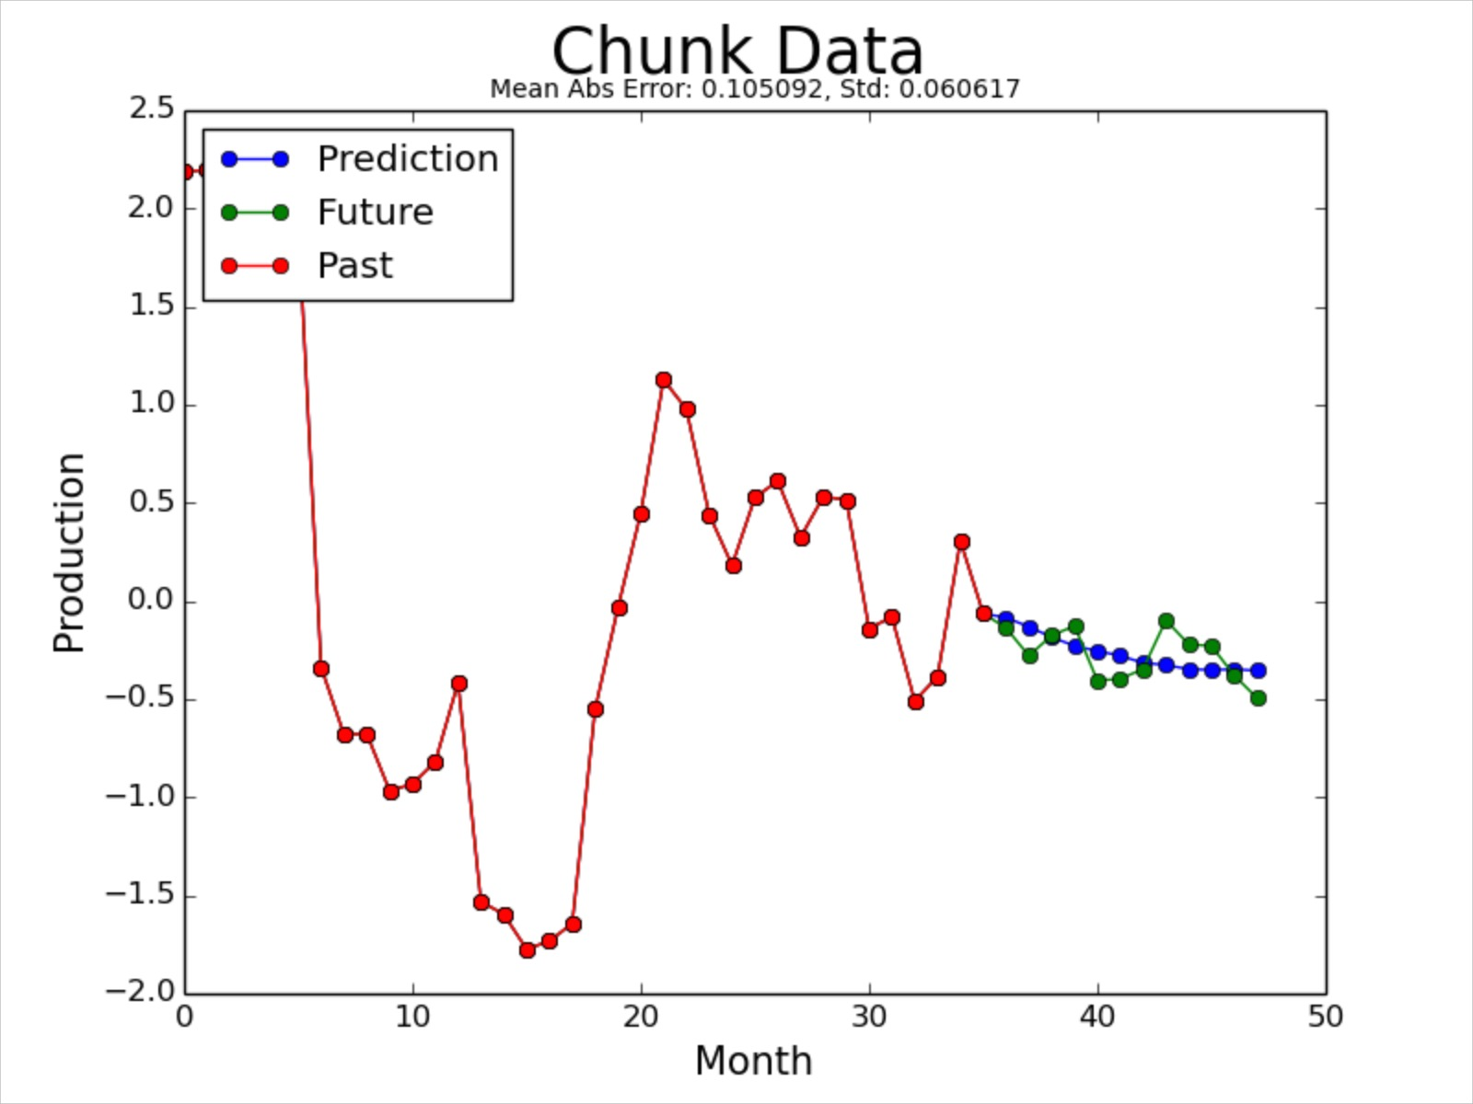
Training on QRI Data
Convolutional Neural Network (CNN)
Multilayer Perceptron (MLP)

Slide 14
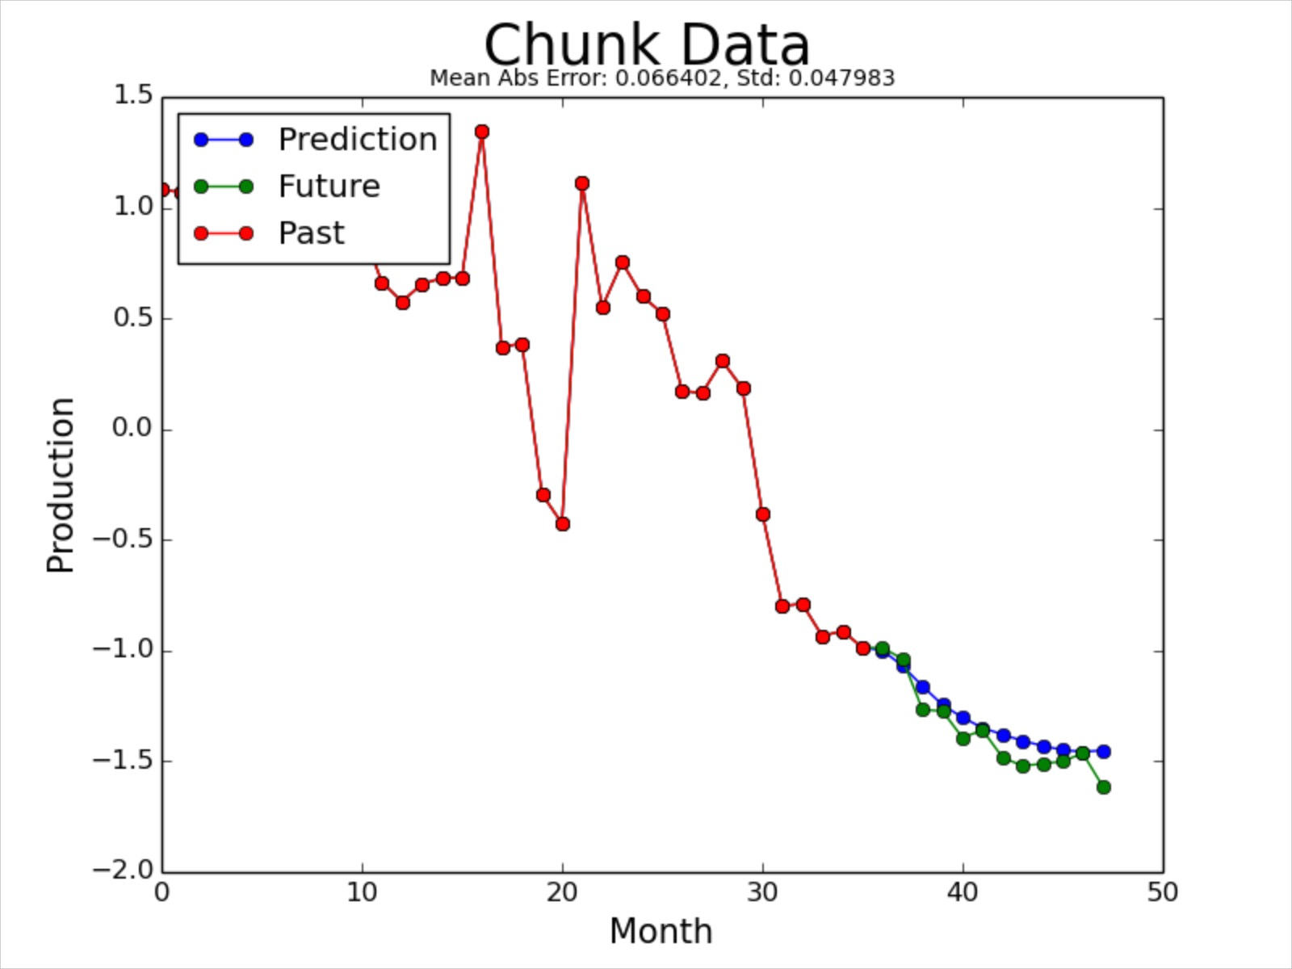
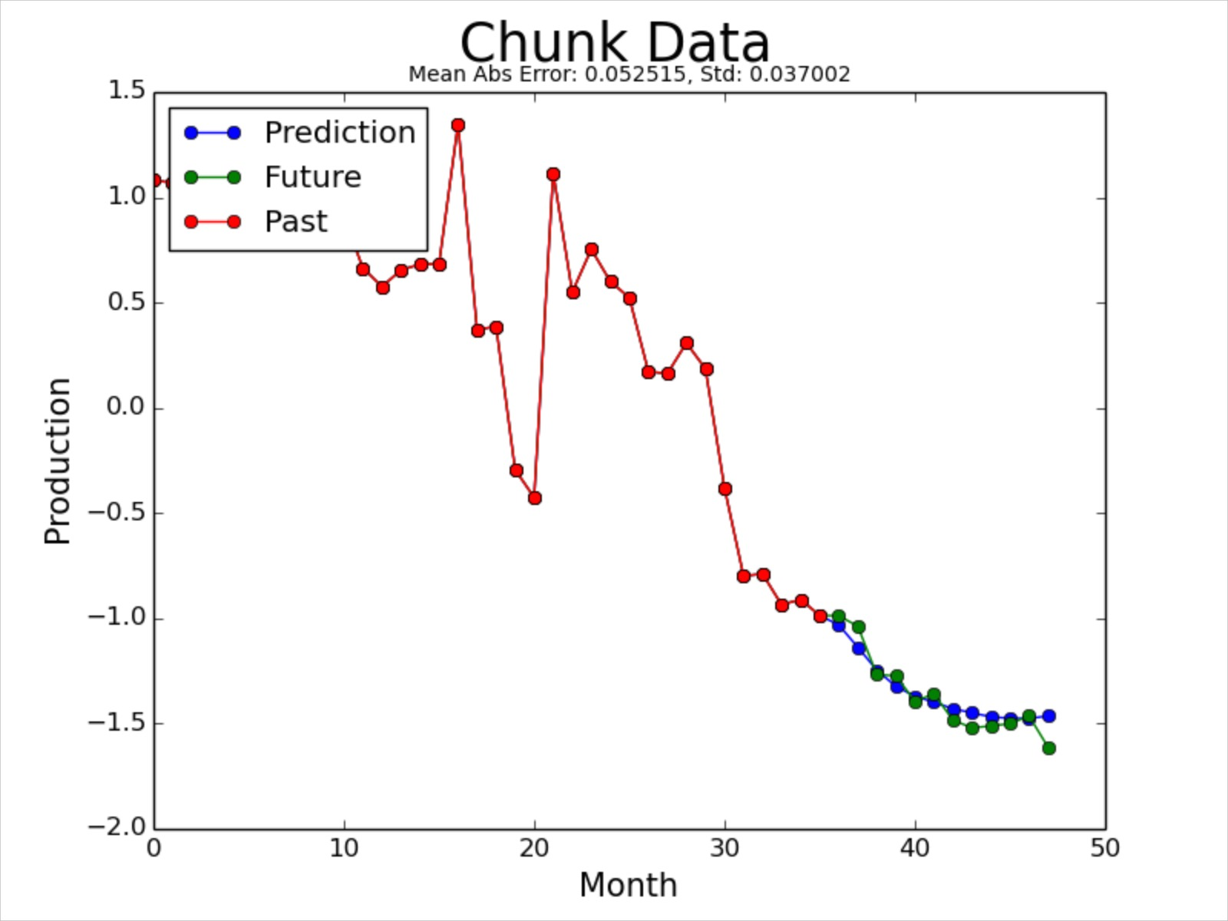
Training on QRI Data
Convolutional Neural Network (CNN)
Multilayer Perceptron (MLP)

Slide 15
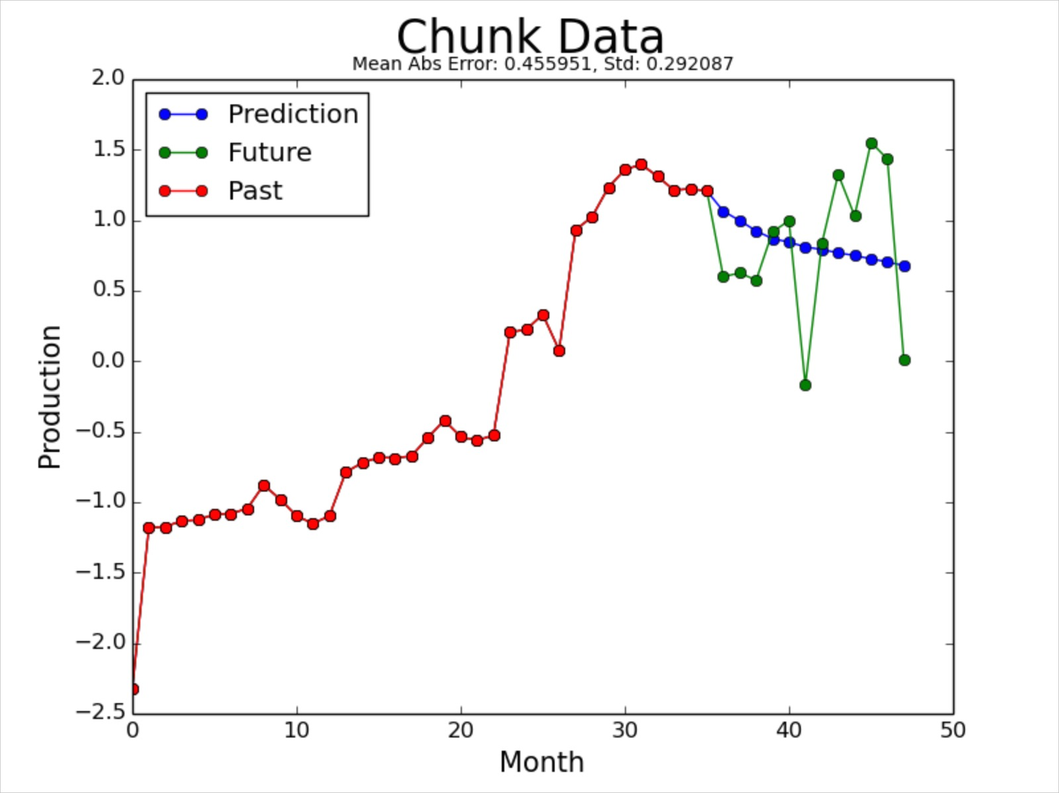
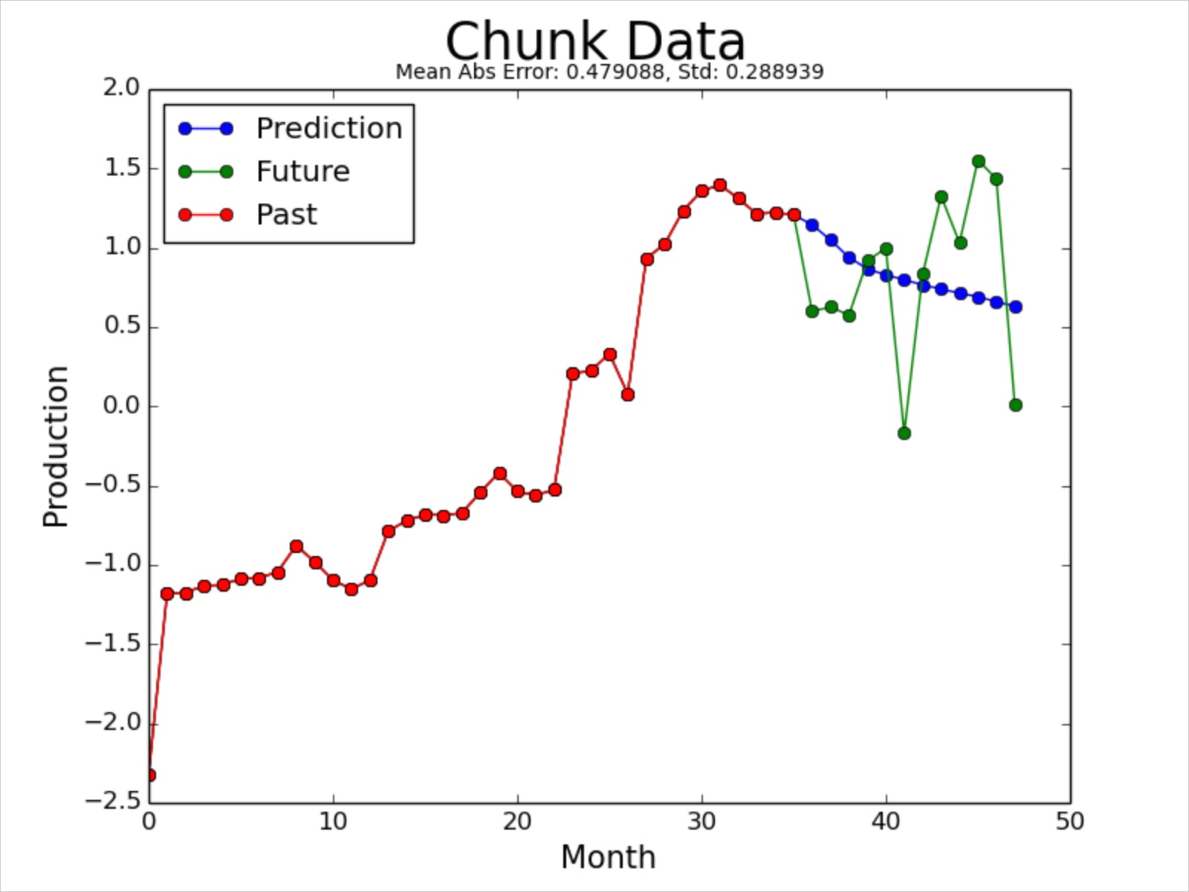
Training on QRI Data
Convolutional Neural Network (CNN)
Multilayer Perceptron (MLP)

Slide 16
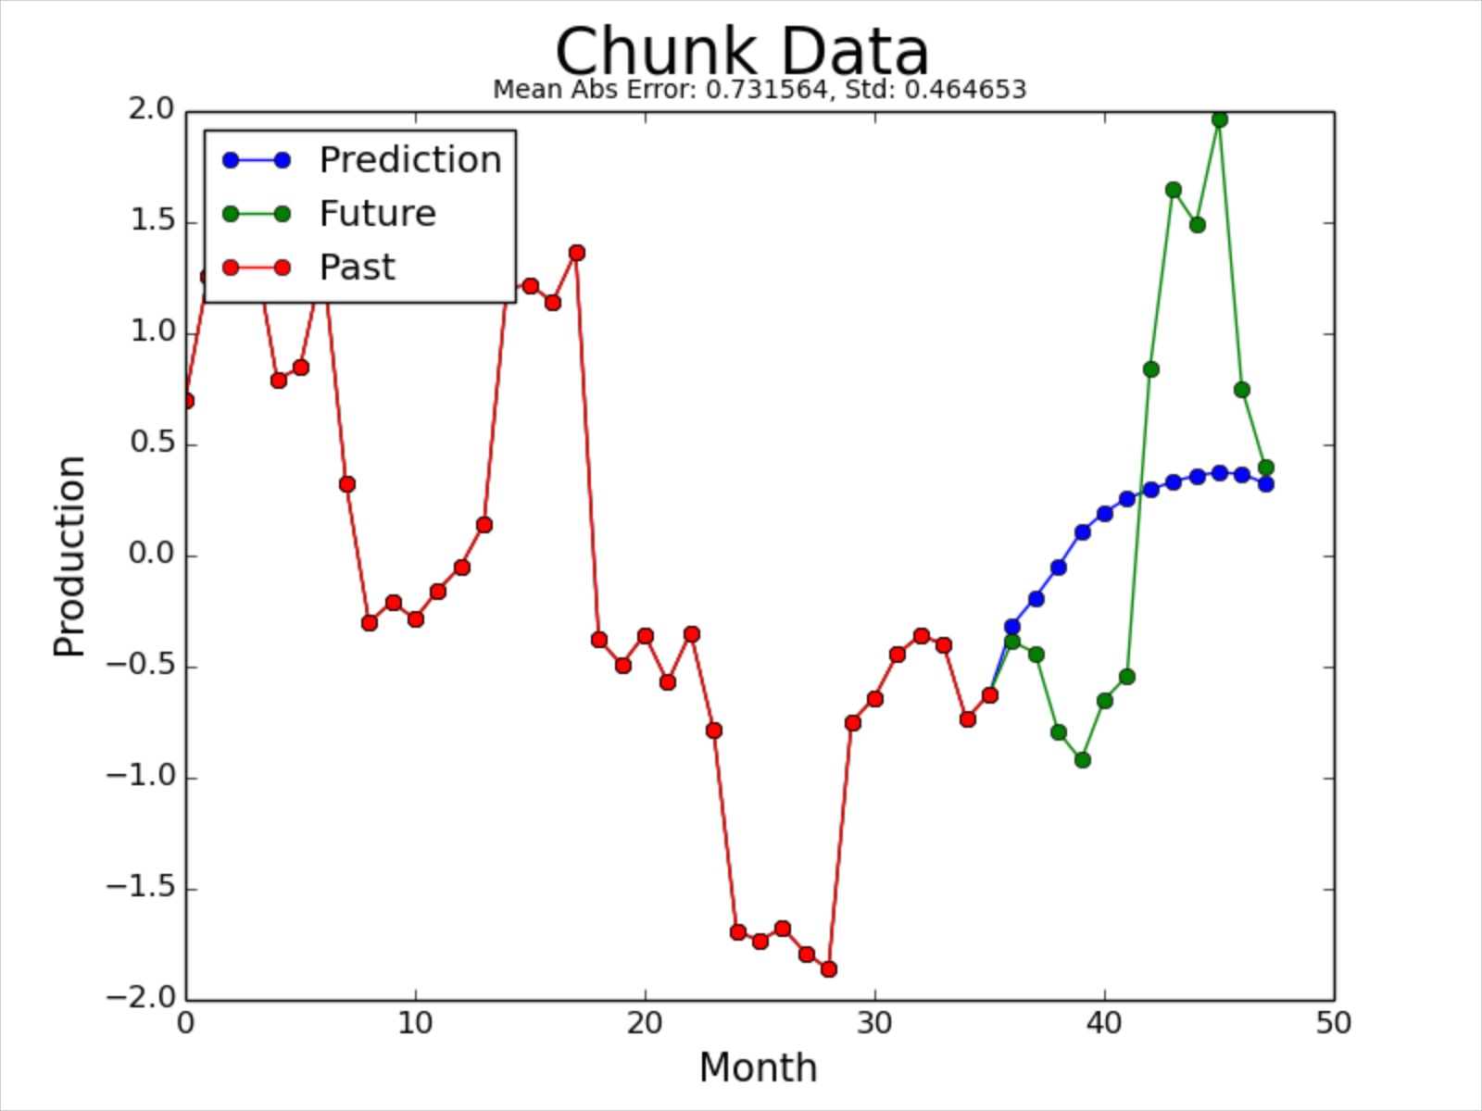
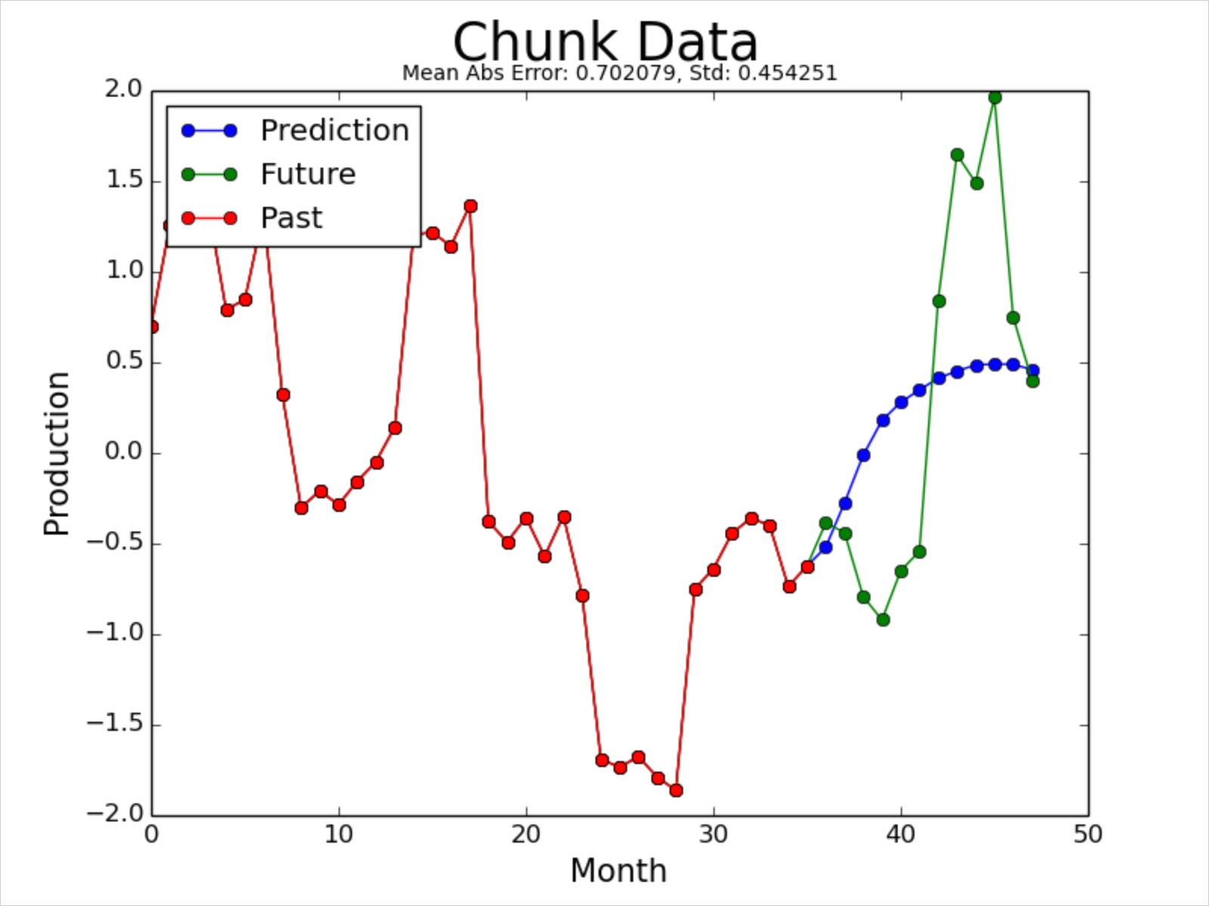
Training on QRI Data
Convolutional Neural Network (CNN)
Multilayer Perceptron (MLP)

Slide 17
Next Steps
Running QRI data on RNN and RBM
Optimizing parameters
Activation function
Batch size
Hidden layers
Learning rate
Momentum

Slide 18
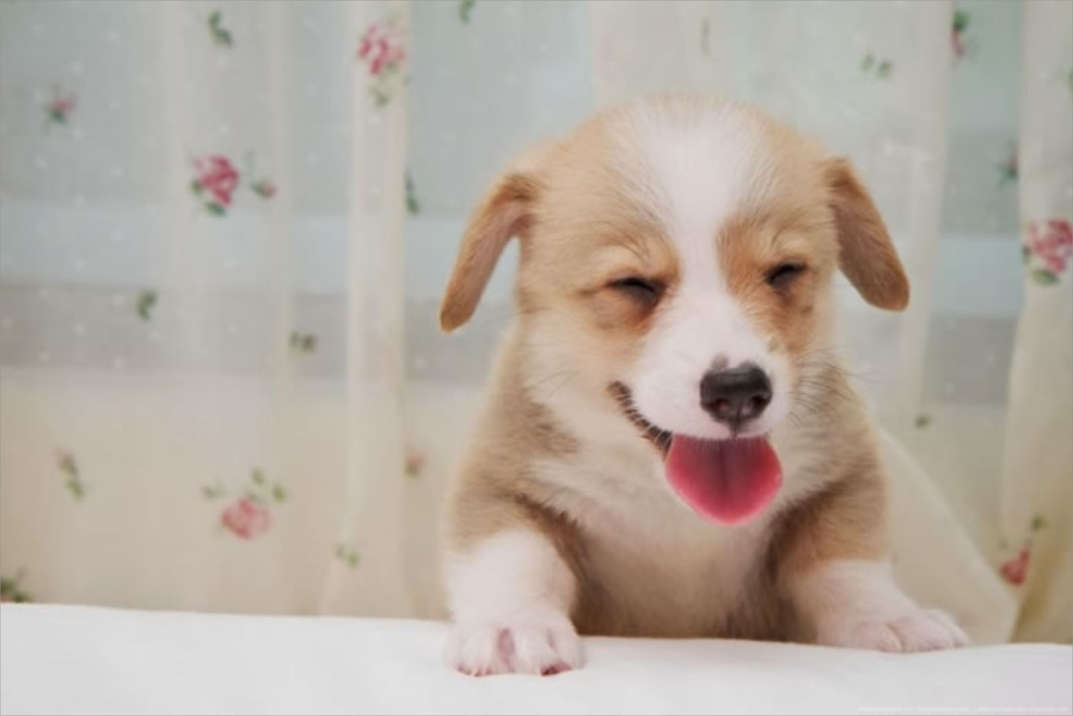
Thank you!
Questions?

Slide 19
Works Cited
Picture slide 2: http://www.sfltimes.com/wp-content/uploads/2015/06/oil-drilling-at-sunset.jpg
RNN LSTM picture: http://www.willamette.edu/~gorr/classes/cs449/figs/lstm.gif
Smiling corgi: http://dailynewsdig.com/wp-content/uploads/2013/11/15.-Smiling-Corgi-Pup.jpg

